Slide 1

PatchManager
PATCH. VERIFY. PROVE IT.
COMMERCIALMANAGED PROFILE
Fill the gap your platform leaves behind
Intune, SCCM or your RMM already own the OS, Office and browsers. PatchManager covers the third-party software they don't — and records every deferral as an audited decision.
Prepared for IT & Security leadership
Complements Intune · SCCM · WSUS · RMM
Notes:
This deck is for an estate that already has Intune / SCCM / WSUS / RMM patching the OS, Office and browsers. The pitch is narrow and precise: don't replace what works — fill the one gap it leaves, and log every deferral as a decision.

Slide 2
THE BOUNDARY
Your platform stops short of the long tail
ALREADY OWNED
NOBODY'S JOB
Your platform patches
The third-party gap
Windows Update
Microsoft 365
WinGet apps
Store apps
.NET / Python / Node
Chrome / Edge
Scoop
Vendor updaters
Utilities & archivers
Reliably delivered through Intune, SCCM, WSUS or your RMM.
The apps with no MDM channel — patched by hand, or not at all.
Notes:
Establish the boundary. Everything on the left has a clear owner today. Everything on the right is the long tail your management platform was never scoped to patch — and it's exactly where unmanaged risk accumulates.

Slide 3
THE PROFILE
Built for a managed estate
CommercialManaged defers OS, Office and browser patching to your platform, then patches the third-party gap it leaves — as one reviewable PowerShell file, deployed by the tooling you already run.
Covers the gap
Defers cleanly
Proves both
Third-party apps, runtimes and vendor updaters your platform doesn't reach.
OS, Office and browsers stay with the system that already owns them.
Every patch and every deferral recorded in one audit-ready report.
Deployed as SYSTEM via Intune or SCCM — no new agent, no service, no dependency.
Notes:
One line: CommercialManaged is the profile built for exactly this. It defers the managed areas to your platform and patches only the gap. It's a single script deployed as SYSTEM by the tooling you already use — no new agent, no service.

Slide 4
THE SPLIT
Exactly what it touches
COVERED BY PATCHMANAGER
DEFERRED TO YOUR PLATFORM
ALWAYS ON — NEVER PATCHES
WinGet third-party packages
Windows Update
Inventory-wide KEV scan
Microsoft Store apps
Microsoft 365 Click-to-Run
Environment staleness
Runtimes — .NET, Python, Node
Chrome, Edge & WebView2
End-of-life exposure
Native vendor updaters
Teams & OneDrive
SLA tracking
Notes:
Get precise about the split. On CommercialManaged the tool automatically disables the Windows Update, Microsoft 365, Chrome, Edge, Scoop and vendor-updater providers, and descopes the managed WinGet packages. What's left is the third-party gap — and the report-only safety nets that never change the machine stay on across the board.

Slide 5
THE SAFETY NET
Deferred is never invisible
The report-only scans keep watching the managed apps too — they never change the machine, so there's no reason to hand them off. A coverage boundary doesn't become a blind spot.
KEV still watches
Lifecycle still checked
Every deferral logged
The inventory-wide CISA KEV scan covers all installed software — including the apps your platform owns.
Staleness and end-of-life scans flag out-of-support Windows or an EOL browser line your platform may miss.
Each descoped item appears in the report with its reason — a decision an auditor can see, not a silent miss.
If your platform falls behind on an actively-exploited app, the report still raises it.
Notes:
The key reassurance for a managed estate: deferring is not the same as ignoring. The report-only safety nets keep watching the managed apps too. If your platform falls behind on an actively-exploited Chrome, PatchManager still flags it. Coverage boundaries don't become blind spots.

Slide 6
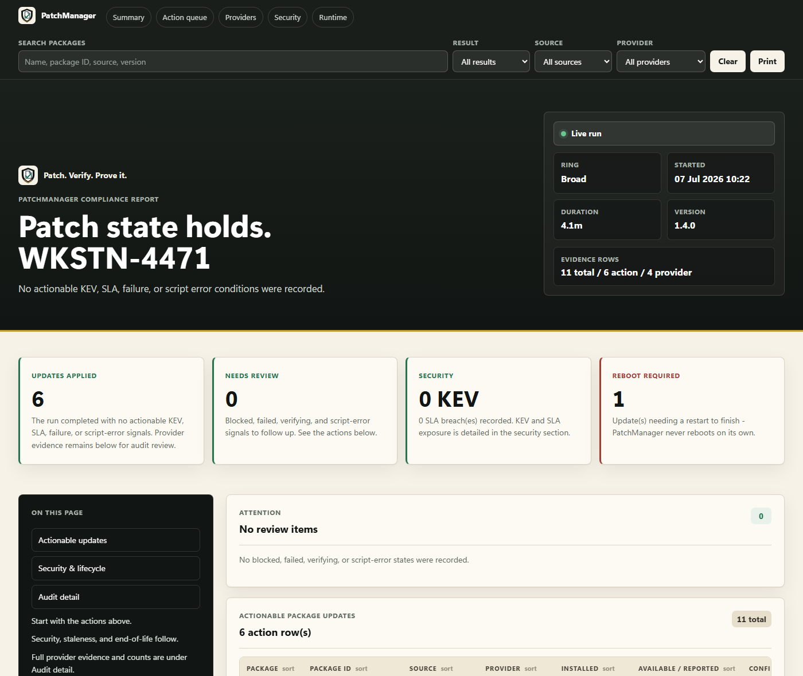
PROOF
One record, patched and deferred alike
Every row records what was checked, what changed, and — for a deferred item — exactly why it was left to your platform.
HTML
Interactive — search, filter, sortable, print-friendly.
JSON
Full machine-readable results for automation.
CSV
Flat per-row export for SIEM, Excel or Power BI.
Descoped rows carry their reason, so an auditor sees precisely what was deferred and why.
Notes:
The audit story. Because everything — patched, deferred, flagged — lands in one report, you get a single defensible record per device. HTML for people, JSON for automation, CSV for the SIEM, rolled up estate-wide in the fleet dashboard. Point to the sample.

Slide 7
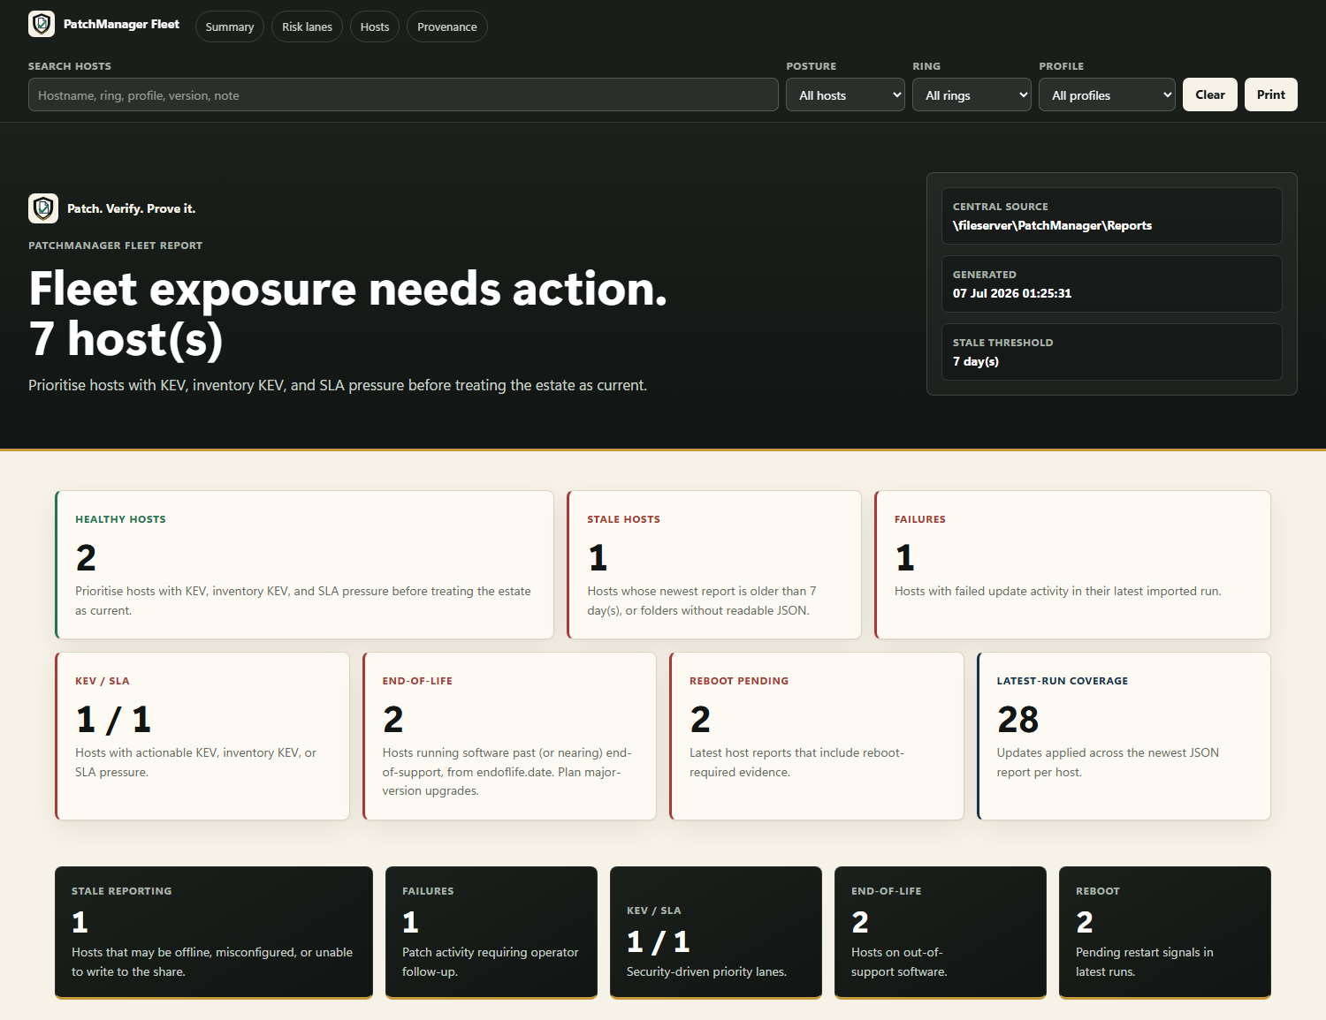
DEPLOYMENT
Rolls out with tools you own
Deploy as SYSTEM
Ship the script via Intune Win32, SCCM or GPO to an admin-only path.
Rings & schedule
Assign Pilot / Early / Broad by registry; run nightly with jitter and a maintenance window.
Central evidence
Point reports at a share; roll up the estate in the fleet dashboard; ingest events into the SIEM.
Self-update off
Your platform owns deployment — the script won't update itself behind your back.
Notes:
How it deploys without disruption. Stage the script via Intune or SCCM, drop a config with the managed profile and your central share, assign rings, schedule nightly, and wire events into the SIEM. Self-update is off by default here — a managed estate's own tooling should own how the script is deployed. Point to the fleet dashboard.

Slide 8
THE RECOMMENDATION
Pilot it on the third-party gap — nothing else changes.
No overlap
No blind spots
No licence cost
Your platform keeps the OS, Office and browsers — untouched.
KEV, lifecycle and SLA scans watch the whole estate, managed apps included.
Zero fees, no agent — deployed by the tooling you already operate.
PATCH. VERIFY. PROVE IT.
Notes:
Close the same way as the commercial proposal: a narrow, low-risk ask. This doesn't touch what your platform does — it closes the one gap it leaves, for zero licence cost, with evidence. Propose a short pilot on the Pilot ring.

